Slide 1

Key Consultation Slides
Slides showing year proposed year group plans and sample lessons consulted on in June 2021

Slide 2
Reception
Parent information session re: RSE
Friday 11th June, 1pm.

Slide 3
 | Lesson 1 | Lesson 2 | Lesson 3
Reception | I can name parts of the body. | I can tell you some things I can do to stay healthy. | I can understand that we all grow from babies to adults.
 | Lesson 4 | Lesson 5 | Lesson 6
 | I can express how I feel about moving to Year 1. | I can talk about my worries about moving to Year 1. | I can share memories of the best bits of Reception.

Slide 4
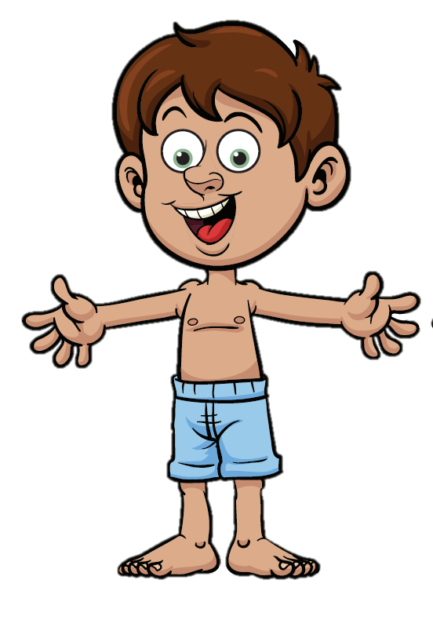
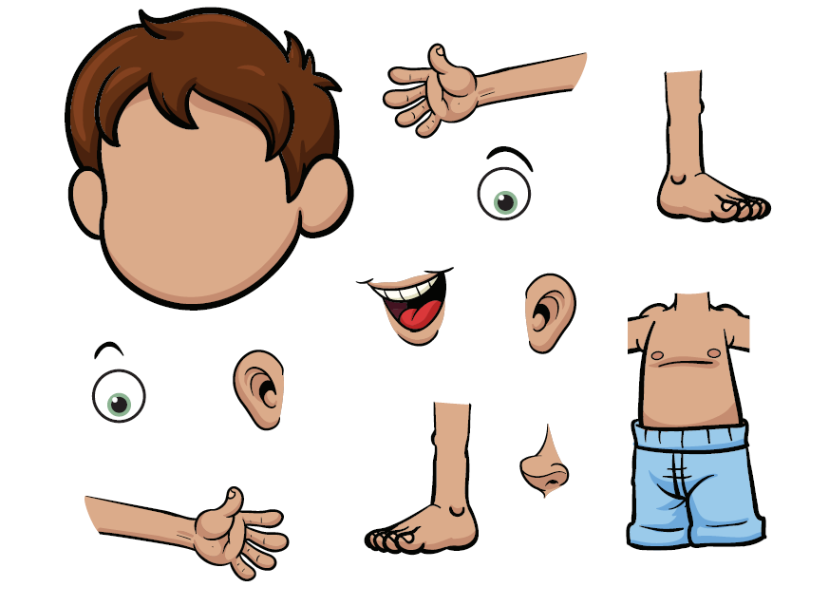
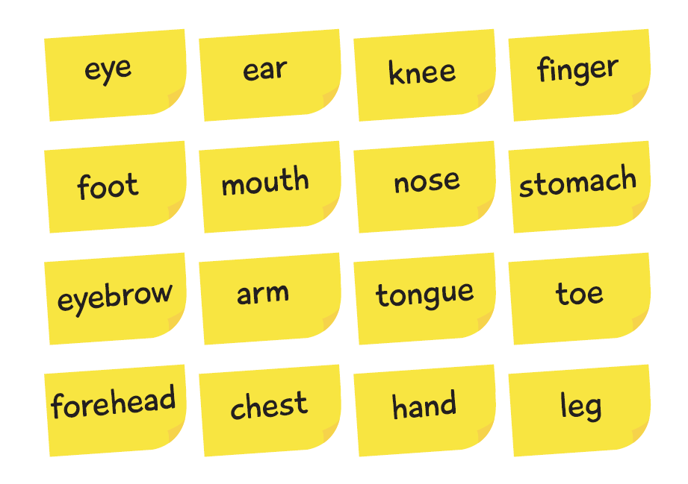
Lesson 1

Slide 5
 | Lesson 1 | Lesson 2 | Lesson 3
Year 1 | I am starting to understand the life cycle of humans. | I can tell you some things about me that have changed. | I can tell you how my body has changed since I was a baby.
 | Lesson 4 | Lesson 5 | Lesson 6
 | I can identify the parts of the body that make boys different to girls. | I understand that every time I learn something new, I change a bit. | I can tell you about changes that have happened in my life.

Slide 6
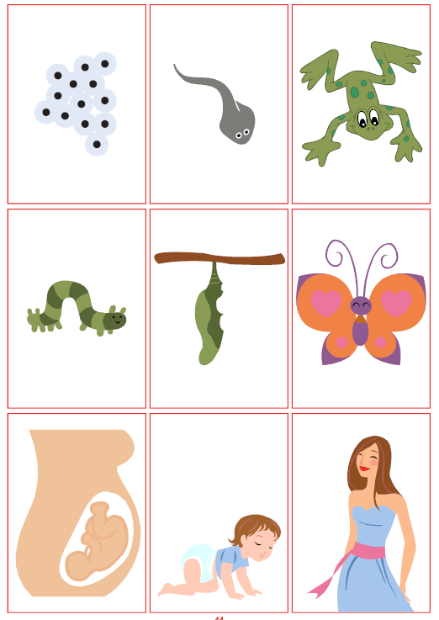
Lesson 1

Slide 7
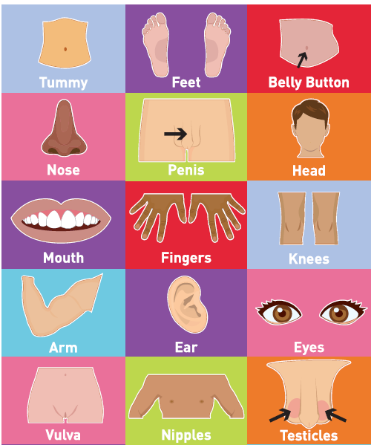
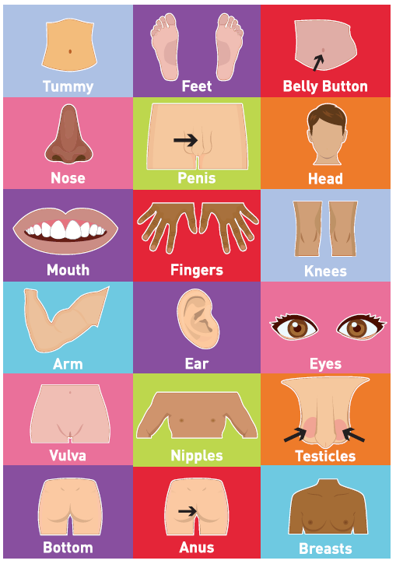
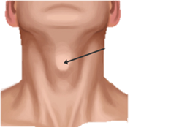


Lesson 4
Here is the vocabulary we will be using
Here is the vocabulary suggested by our scheme of work
Adam’s Apple
Eye Lashes
Tummy to carry babies in

Slide 8
Year 2
Parent information session re: RSE
Friday 11th June, 2:15pm.

Slide 9
 | Lesson 1 | Lesson 2 | Lesson 3
Year 2 | I can recognise cycles of life in nature. | I can tell you the natural process of growing from young to old. | I can tell you how my body has changed since I was a baby and how it might change in the future.
 | Lesson 4 | Lesson 5 | Lesson 6
 | I can identify the physical differences between boys and girls using the correct terminology. | I understand there are different types of touch and can tell you which ones I like and which ones I don’t. | I can identify what I am looking forward to when I move to Year 3.

Slide 10
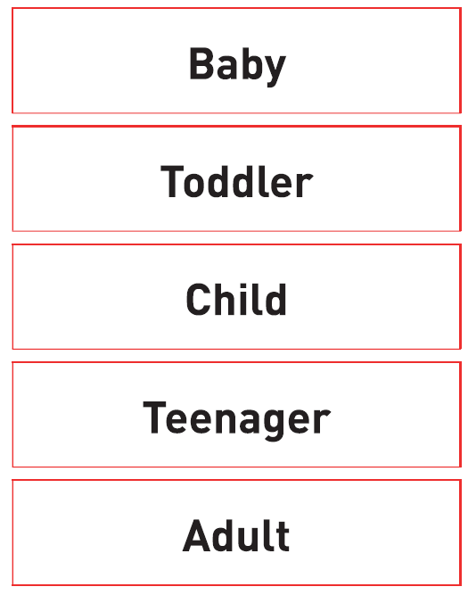
Lesson 3

Slide 11
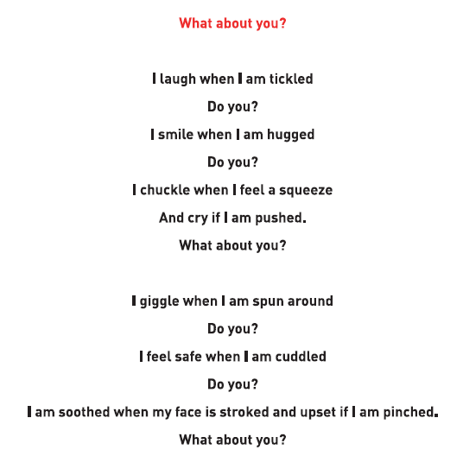
Lesson 5

Slide 12
Year 3
Parent information session re: RSE
Monday 14th June, 9:15am.

Slide 13
 | Lesson 1 | Lesson 2 | Lesson 3
Year 3 | I understand that changes happen between birth and growing up. | I understand how babies grow and develop in a mother’s uterus. | I can identify how girls’ and boys’ bodies need to change on the outside so when they’re older their bodies can make babies.
 | Lesson 4 | Lesson 5 | Lesson 6
 | I can identify how girls’ and boys’ bodies need to change on the inside so when they’re older their bodies can make babies. | I can recognise stereotypical ideas I might have about parenting and family roles. | I can identify what I am looking forward to when I move to Year 4.

Slide 14
Lesson 2
We have edited the images to just show the baby bump and the woman’s stomach

Slide 15
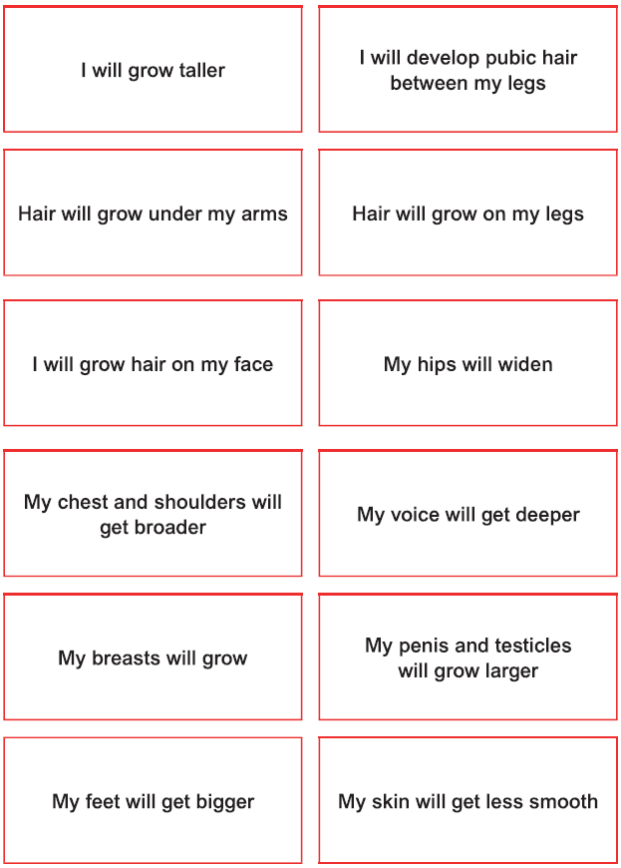
Lesson 3
This is what we have removed the recommended scheme of work
This is the scheme of

Slide 16
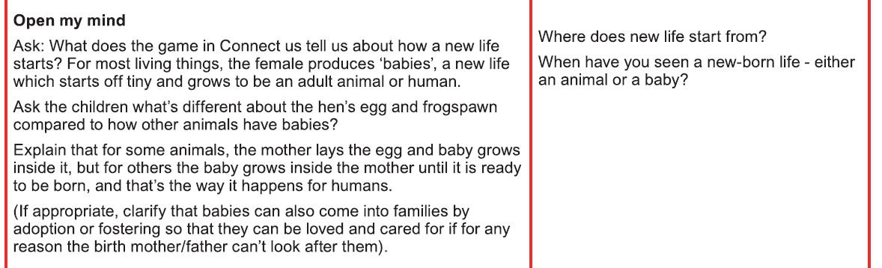
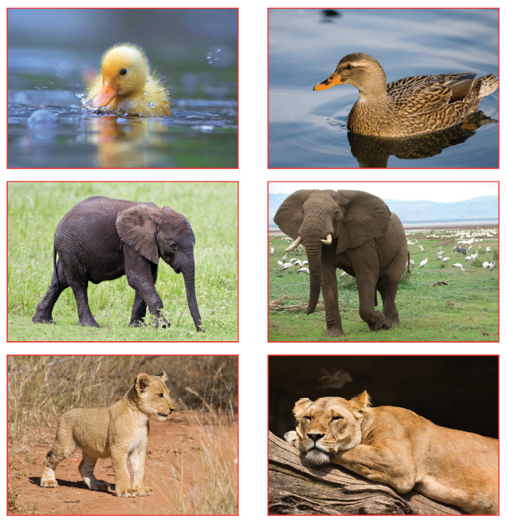
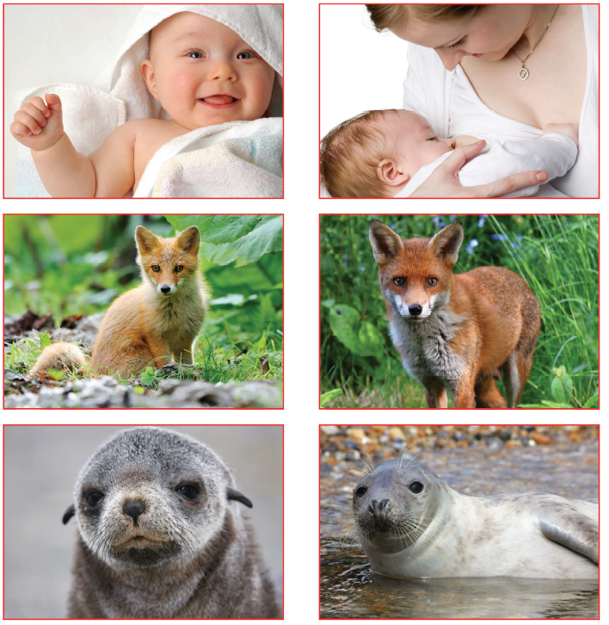
Lesson 4

Slide 17
Year 4
Parent information session re: RSE
Monday 14th June, 10am.

Slide 18
 | Lesson 1 | Lesson 2 | Lesson 3
Year 4 | I understand that some of my characteristics come from my birth parents because of the joining of egg and sperm. | I can understand what responsibilities there are in parenthood and the joy it can bring. | I understand how a girl’s body changes in order to have a baby and that menstruation (periods) is a natural part of this.
 | Lesson 4 | Lesson 5 | Lesson 6
 | I know how the circle of change works and can apply it to changes I want to make in my life. | I can identify changes that have been, and may continue to be, outside of my control. | I can identify what I am looking forward to when I move to Year 5.

Slide 19
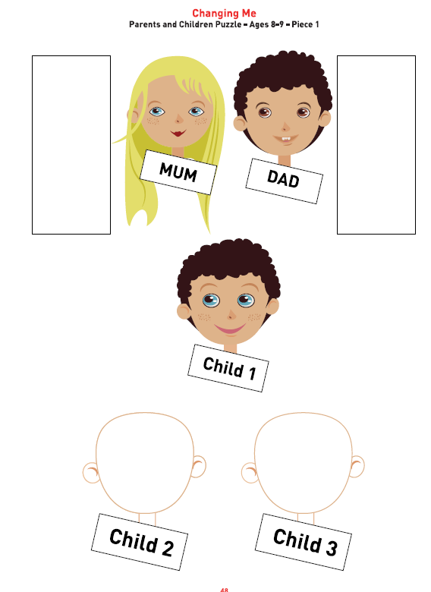
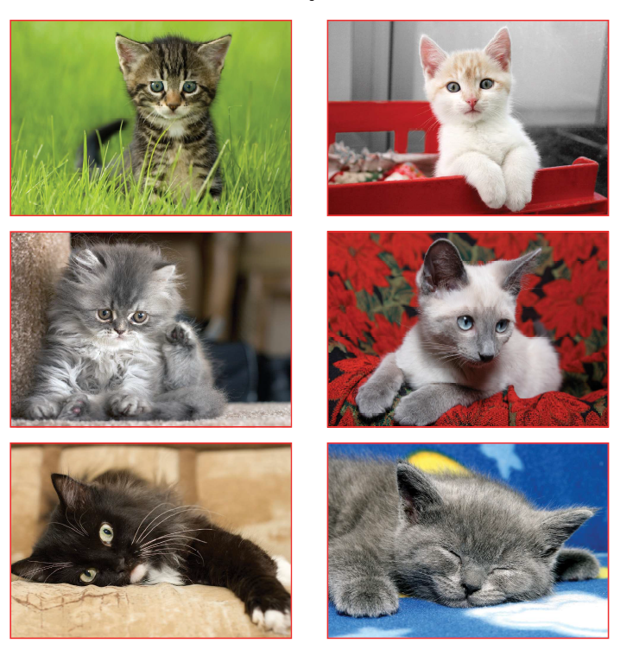
Lesson 1
Looks at genetics and how we get some of our looks from our parents.

Slide 20
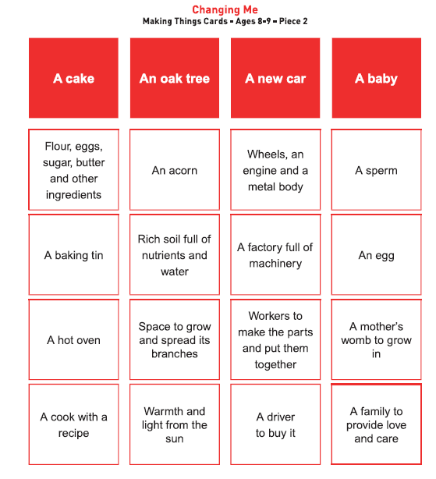
Lesson 2

Slide 21
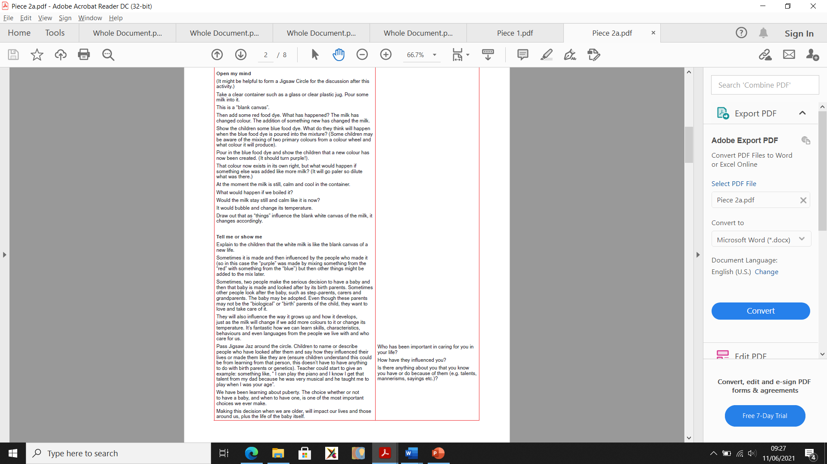
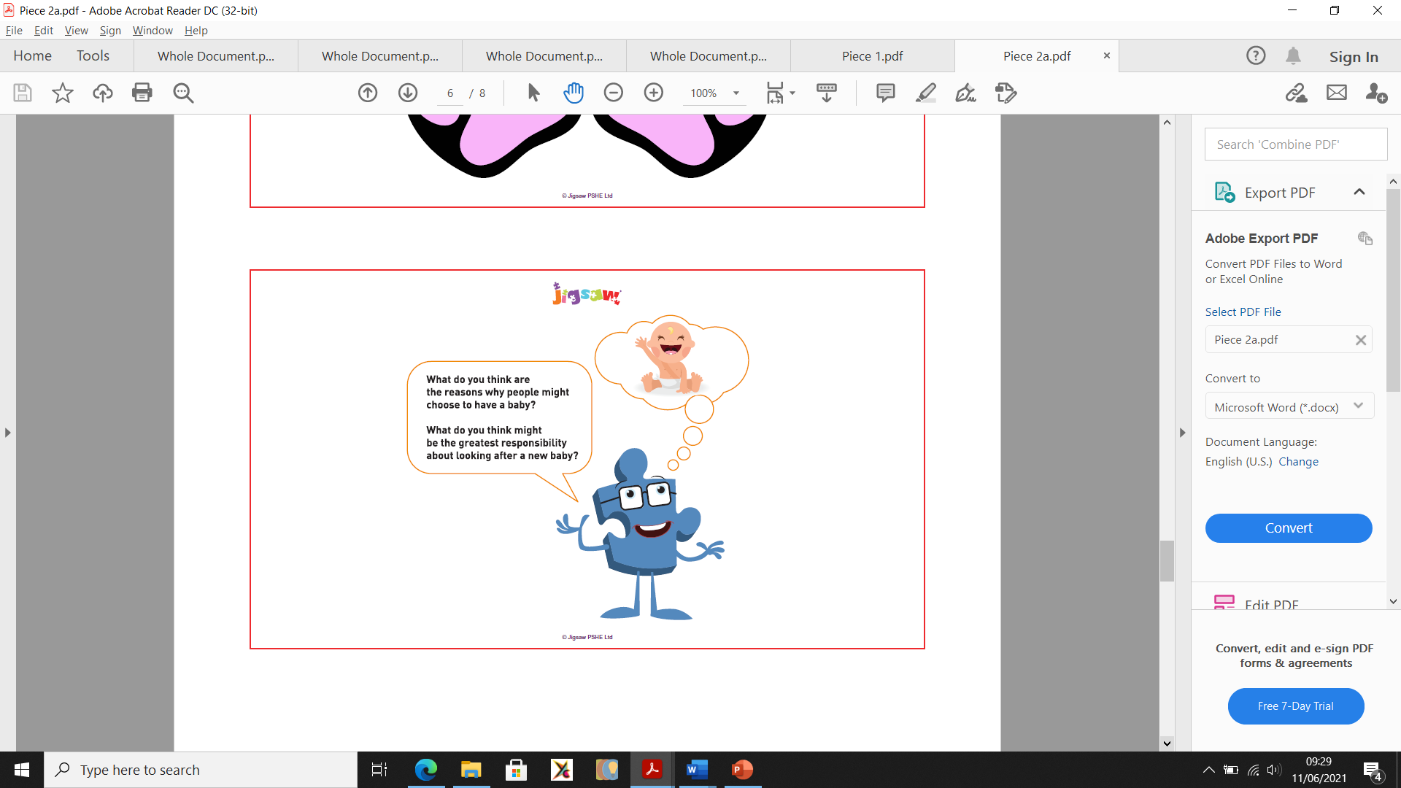
Lesson 2
Discussion:
Task:

Slide 22
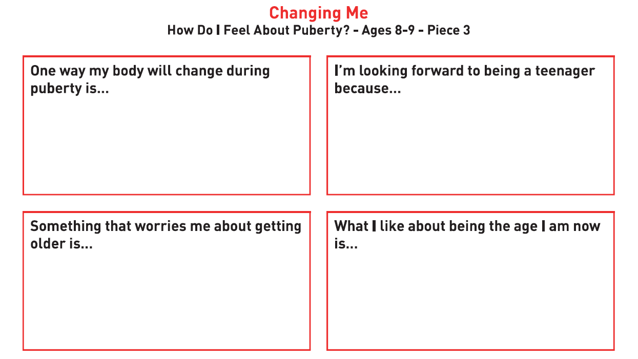
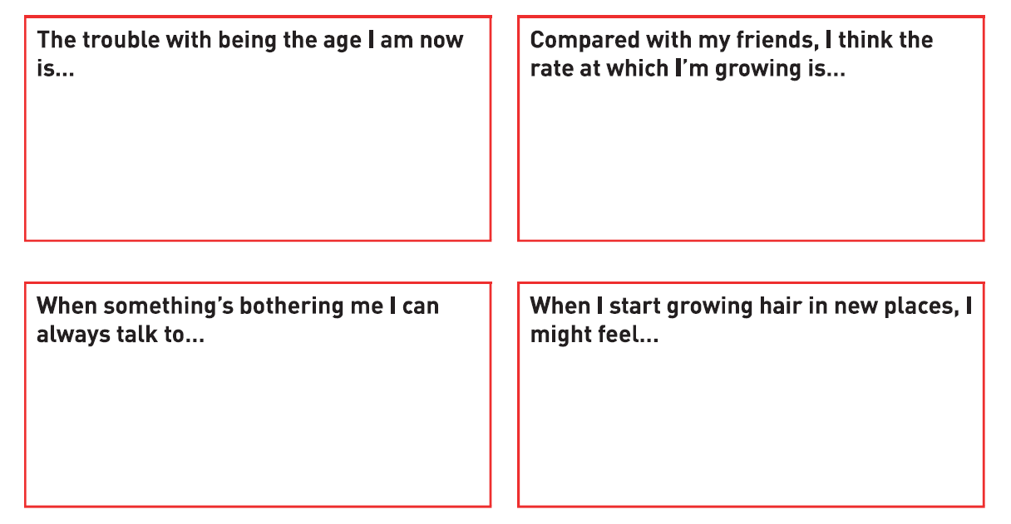
Lesson 3
Please note, boys and girls will be taught this session separately – to allow more chance for discussion.

Slide 23
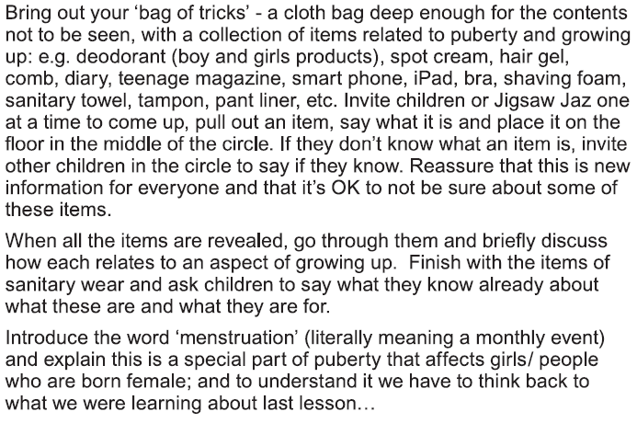
Lesson 3
Please note, boys and girls will be taught this session separately – to allow more chance for discussion.
This will be followed by a discussion about menstruation and periods – no images will be used and it will be driven by your children’s questions.

Slide 24
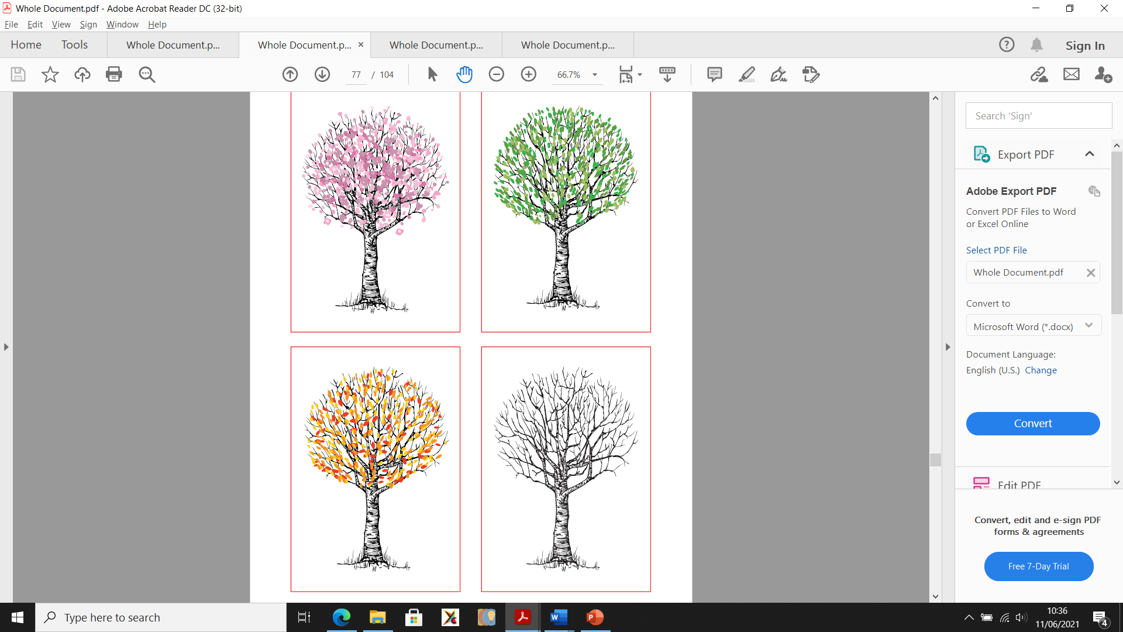
Lesson 4
The circle of change:

Slide 25
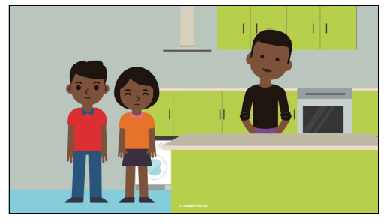
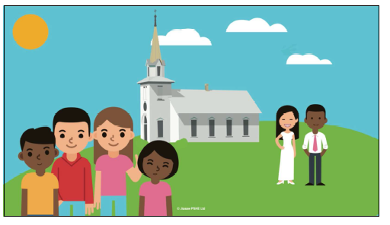
Lesson 4
It talks about changes in circumstances, family dynamics and schools.

Slide 26
Year 5
Parent information session re: RSE
Monday 14th June, 11am.

Slide 27
 | Lesson 1 | Lesson 2 | Lesson 3
Year 5 | I am aware of my own self-image and how my body fits into that. | I can explain how a girls’ body changes during puberty and understand the importance of self-care. | I can describe how both girls’ and boys’ bodies change during puberty.
 | Lesson 4 | Lesson 5 | Lesson 6
 | I understand that intercourse can lead to conception and that is usually how babies are made. | I can identify what I am looking forward to about becoming a teenager and understand this brings growing responsibilities. | I can identify what I am looking forward to when I move to Year 6.

Slide 28
Living things and their habitats
Pupils should be taught to:
describe the differences in the life cycles of a mammal, an amphibian, an insect and a bird
describe the life process of reproduction in some plants and animals

Slide 29
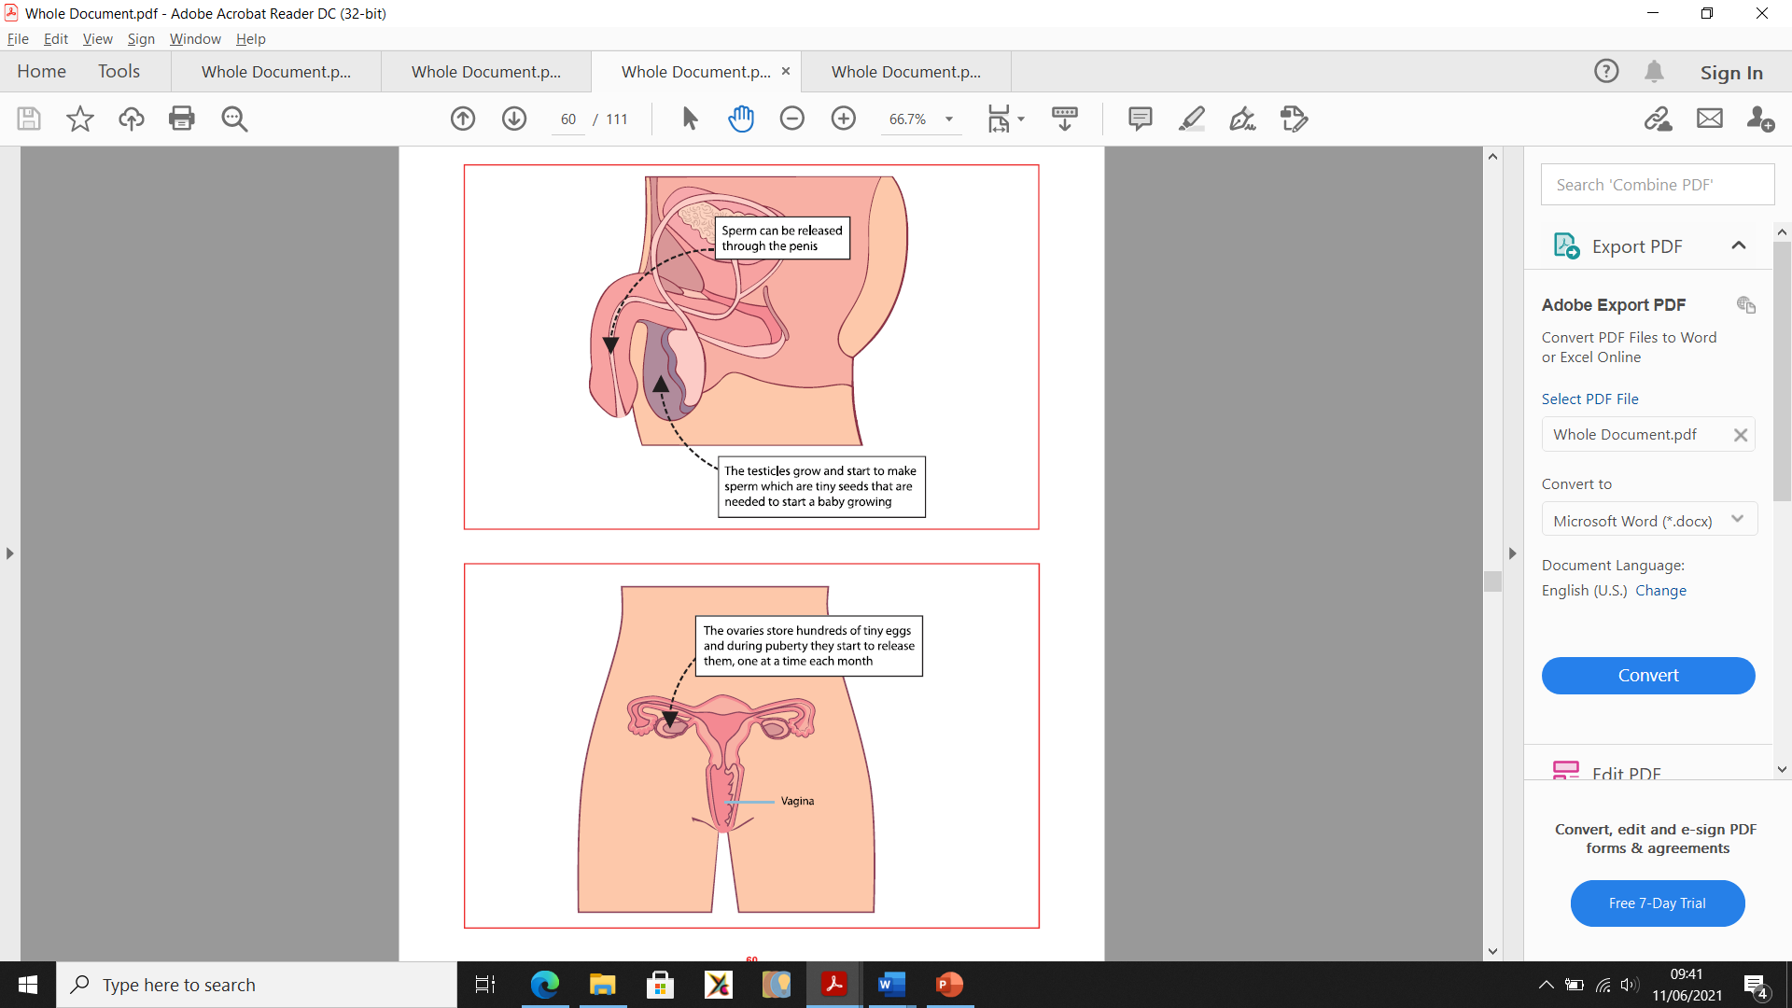
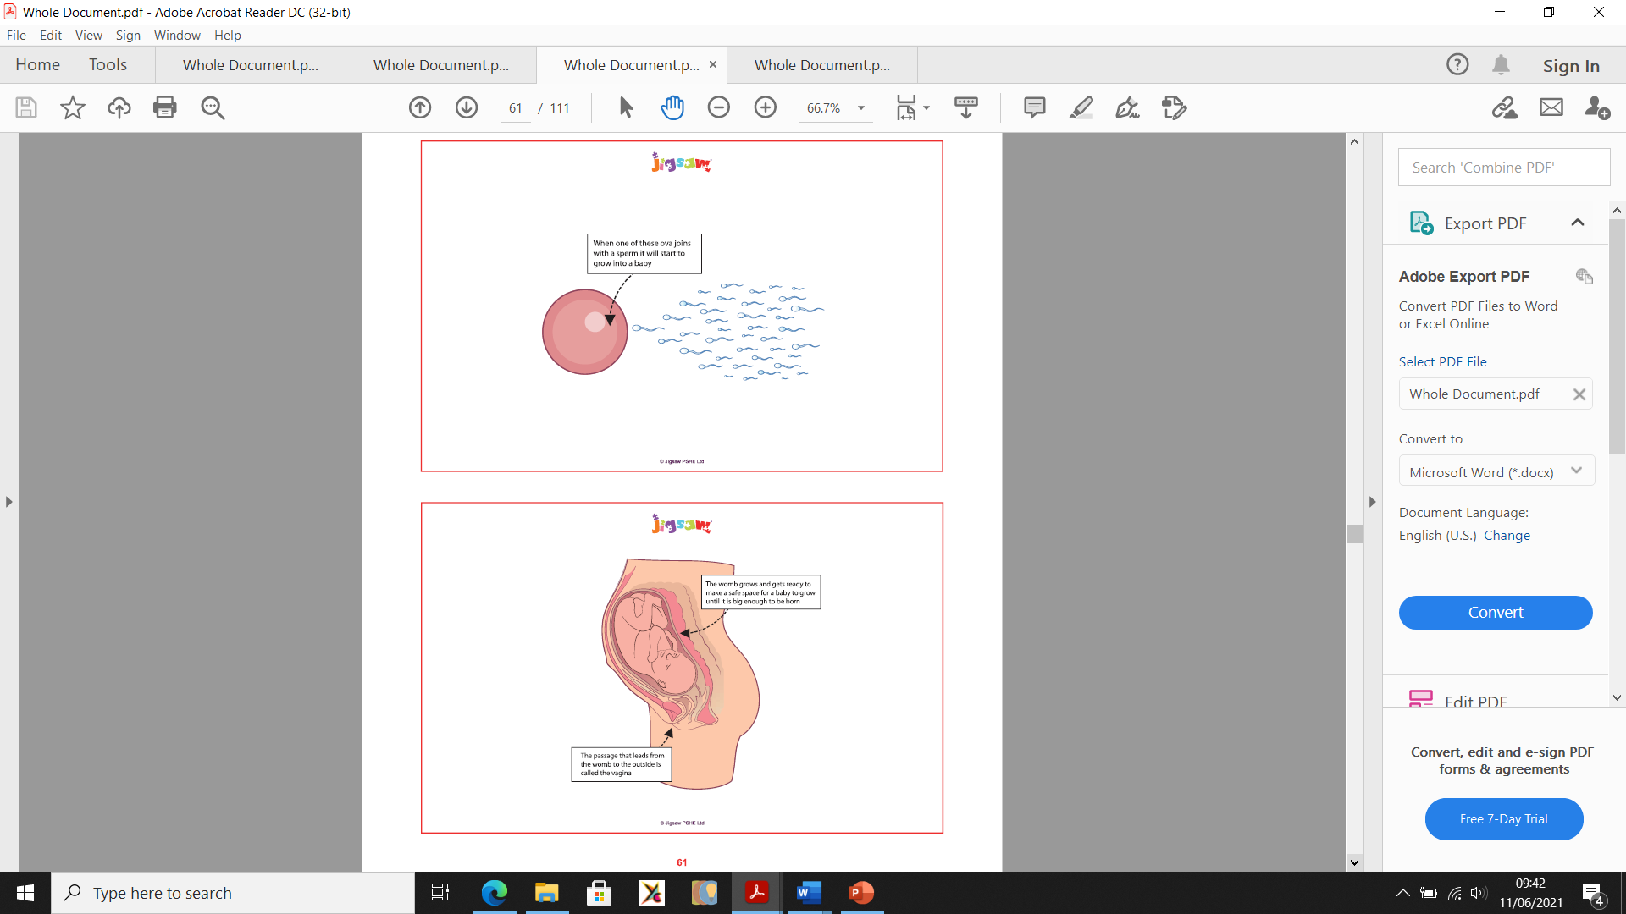
Lesson 2
Please note, boys and girls will be taught this session separately – to allow more chance for discussion.

Slide 30
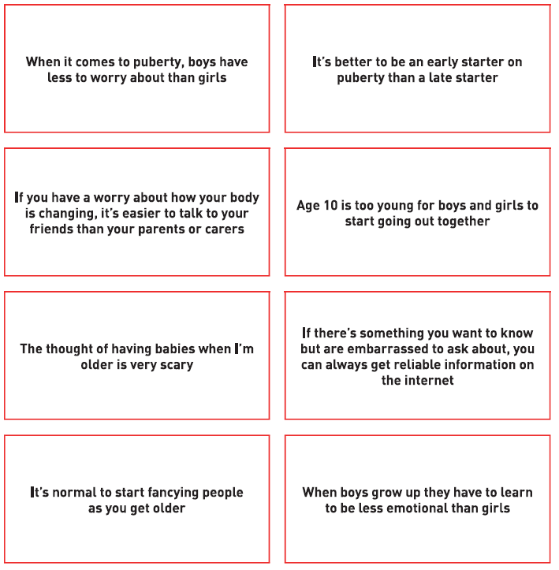
Lesson 3
Agree
or
Disagree?
Please note, boys and girls will be taught this session separately – to allow more chance for discussion.

Slide 31
Year 6
Parent information session re: RSE
Monday 14th June, 11:45am.

Slide 32
 | Lesson 1 | Lesson 2 | Lesson 3
Year 6 | I am aware of my own self-image and how my body fits into that. | I can explain how a girls’ and boys’ bodies change during puberty and understand the importance of self-care. | I can describe how a baby develops, from conception, through pregnancy and how it is born.
 | Lesson 4 | Lesson 5 | Lesson 6
 | I know myself well enough to maintain positive relationships with others whilst keeping my own identity. | I am aware of the importance of positive self-esteem and know how to challenge negative ‘body-talk’. | I can identify what I am looking forward as I transition to secondary school.

Slide 33

Lesson 2
Find someone who…
Please note, boys and girls will be taught this session separately – to allow more chance for discussion.

Slide 34
Lesson 3

Slide 35

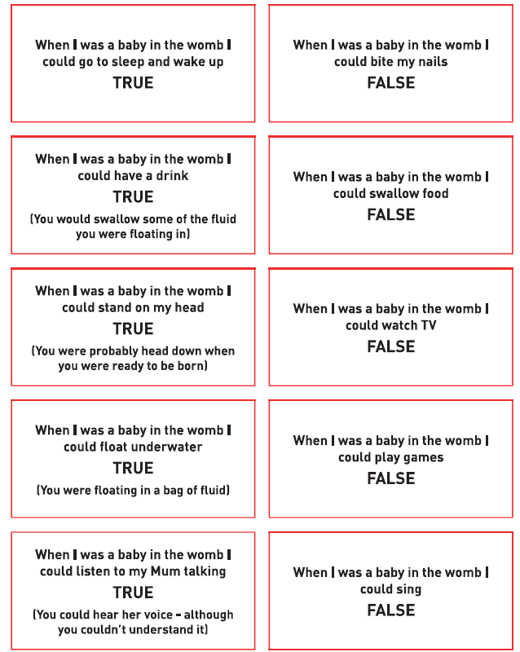
Lesson 3

Slide 36
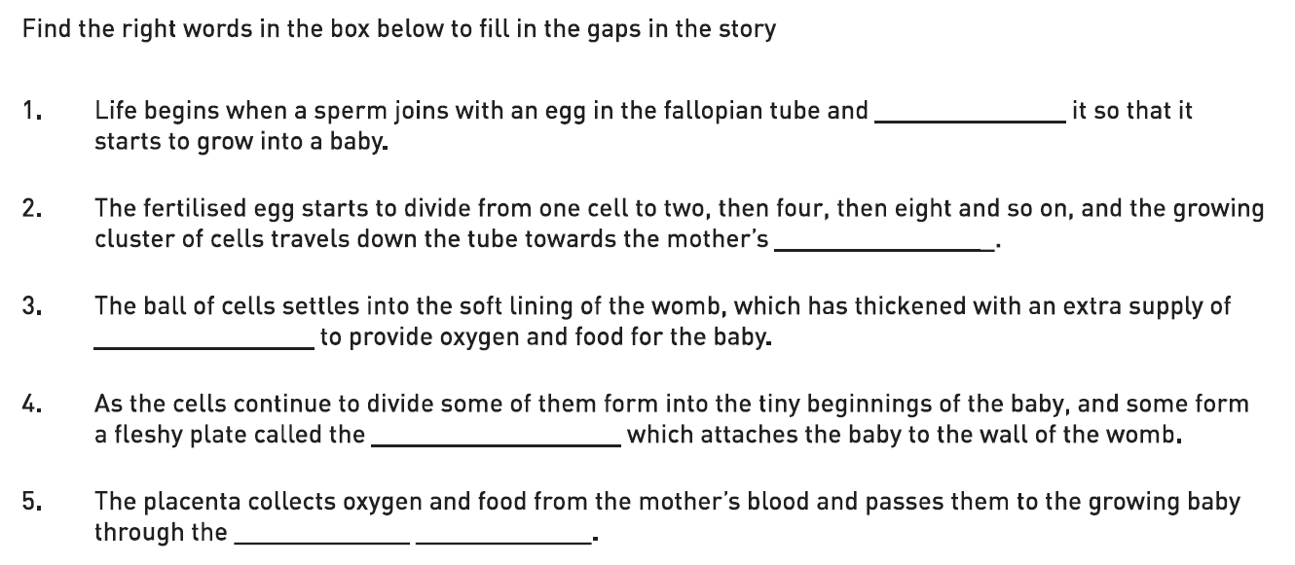
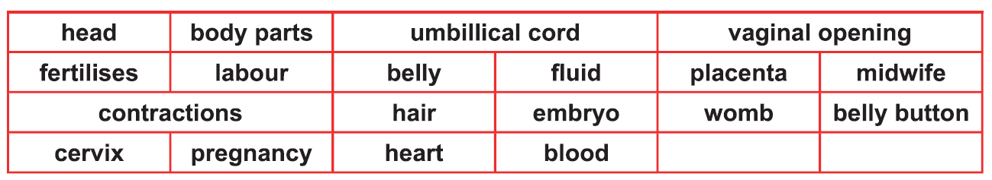
Lesson 3

Slide 37
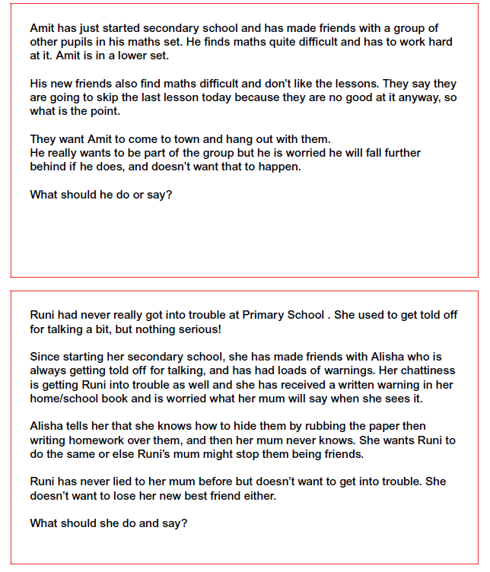
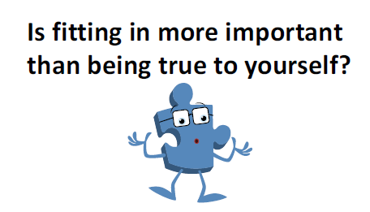
Lesson 4

Slide 38
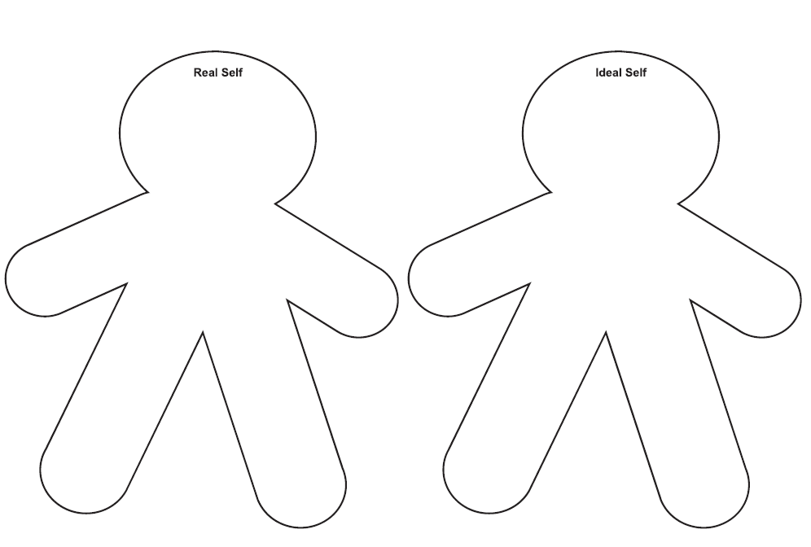
Lesson 5

