Slide 1
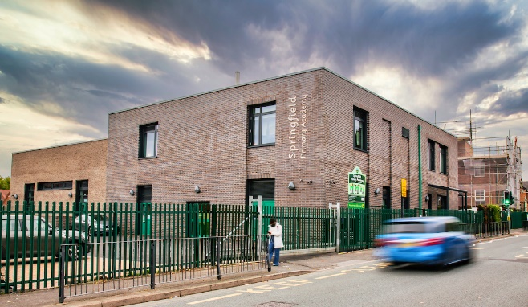
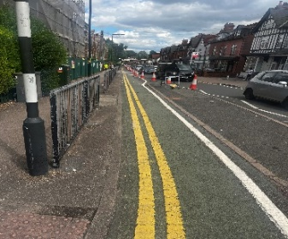

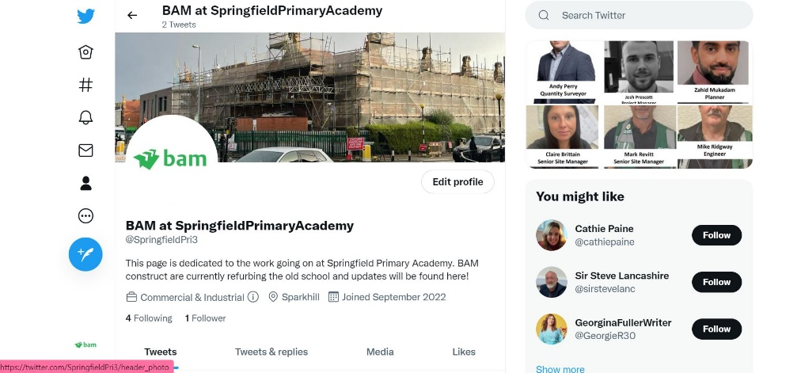
Springfield Primary Academy Development – Phase 2
No. 03 – October 2022
Welcome to Newsletter where we update you on what’s happening on site
Hello,
You may or may not be aware that Springfield Primary Academy have been undergoing a transformation with phase 1 being complete, (the Newbuild facing Springfield road). We have now commenced the 2nd phase being a refurbishment of the existing school.
We will continue to send out Newsletters as the development progresses to keep yourselves and all local residents informed of upcoming key Activities.
Traffic Management
The cycle lane closure is still in place from the hours of 7:30am and 17:00pm.
Deliveries continue to be restricted during school pick up and drop off hours.
If you have any concerns please contact the site team on the number provided.
Upcoming activities
Works to be carried out over the next period are:
Concrete Flooring – currently taking place
Scaffolding - ongoing
Roofing – currently taking place
Brickwork – currently taking place
Ground works & Civils – currently taking place
Cassette flooring system – currently taking place.
Demolition works (potential noisy works) – currently taking place.
Steelwork Install – currently taking place
Want to receive more regular updates with progress on site?
Follow our Twitter Page!
@SpringfieldPri3

Slide 2
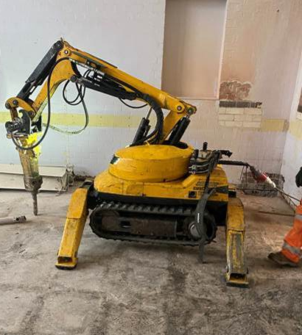

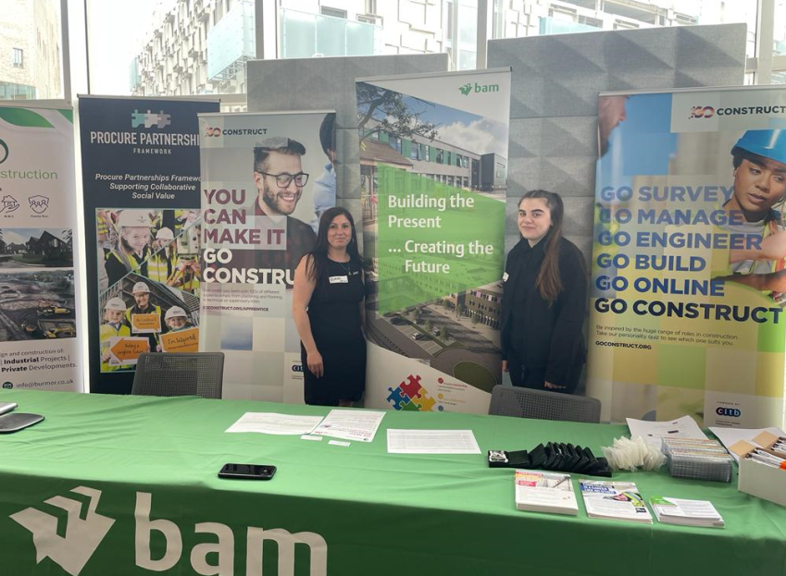
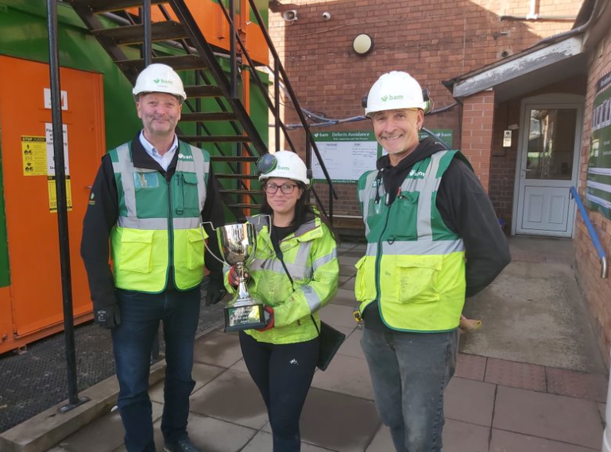
Springfield Primary Academy Development – Phase 2
No.3 October 2022
Environmental
Our aim : Zero Carbon by 2030!
Use of electric plant
Reducing waste going to landfill
Trying to reduce plastic packaging where possible
An electric BROKK that was used at Springfield Primary Academy for the demolition of the floor slabs.
Engagement
How have we engaged with the community within the last month?
Supporting women into construction at a local event
Working with a local college, delivering a community project to help support their learning
Donated floor protection to Springfield Primary Academy following their colour run
Health and safety update
Well done to the team at our Springfield Primary Academy project for winning the 2022 Q3 Health & Safety Award. This is the second time the project has won the award, which is testament to their hard work in what has proven to be an extremely challenging and complex project.
Pictured from left to right: Construction director Bell, Alan, senior site manager Brittain, Claire and senior site manager Revitt, Mark. Construction apprentice Southwell, Niamh could not be present for the presentation but has also helped play a key part in the site's excellent safety performance.
Well done all!
-Quoted from our health and safety advisor.

Slide 3

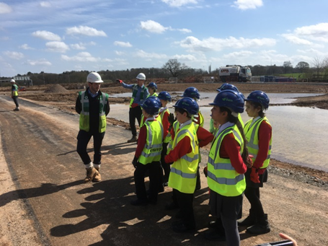
Springfield Primary Academy Development – Phase 2
No.3 October 2022
About BAM
BAM Construction is part of BAM Construct UK which is one of the country’s largest construction services organisations with a turnover of more than £900 million. We operate throughout England, Scotland and
Wales. Our European parent company is Royal BAM Group which employs over 25,000 people worldwide and has a turnover of €7billion.
Contacting the site team:
If you have any questions or concerns about what’s happening at the site, please call us or email
Tel: 07827271564
Considerate Constructor Scheme (CCS)
BAM registers all of its site with the Considerate Constructors Scheme. This means we are committed to being a good neighbour and to being clean, respectful, safe, environmentally conscious, responsible and accountable. Our site is independently inspected to make sure we live up to these aims.
We try to work in a way that causes as little inconvenience as possible to our neighbors. We apologise for any unavoidable nuisance that may be caused during the work.
If you would like to feedback in regard to Springfield Primary Academy, please follow the link below:
https://www.ccscheme.org.uk/feedback/
For more details about BAM visit:
www.bam.co.uk
Please help us with safety
Construction sites can be dangerous. At BAM our top priority is the health and safety of everyone who works on our sites, the public and the local community affected by our work. If you need to contact us, please ring us or call the site office but do not enter the site.
Please make any children in your care aware that our building site is not a playground and that they must not enter the site. Thank you for your co-operation during construction works

