Slide 1
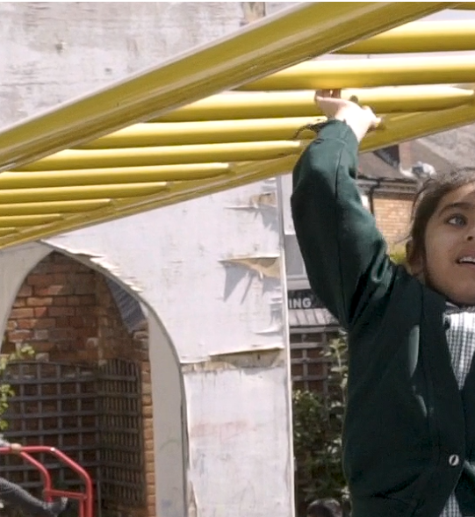
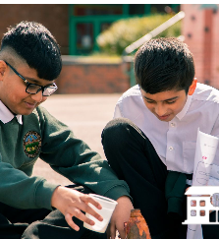

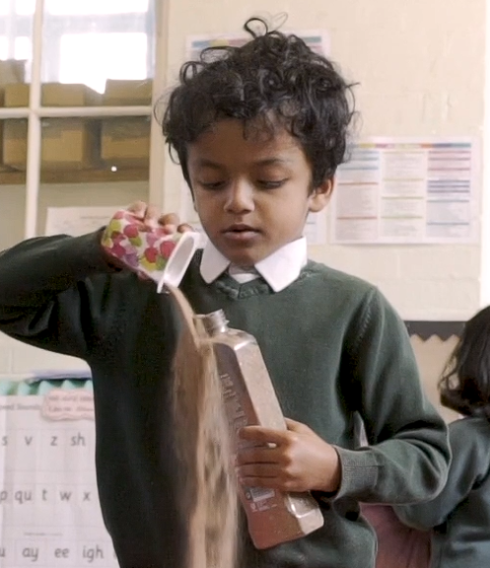
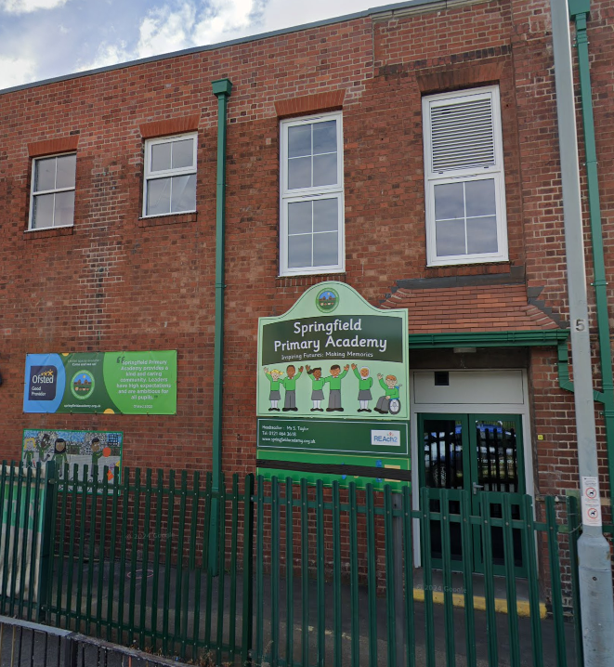
Springfield Primary Academy
Welcome to Reception September 2025-26

Slide 2

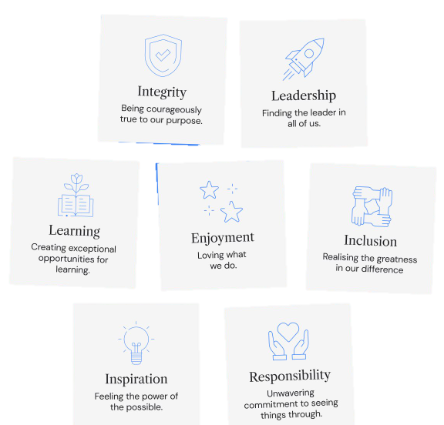
Vision, Mission and Values
Our Touchstones

Slide 3
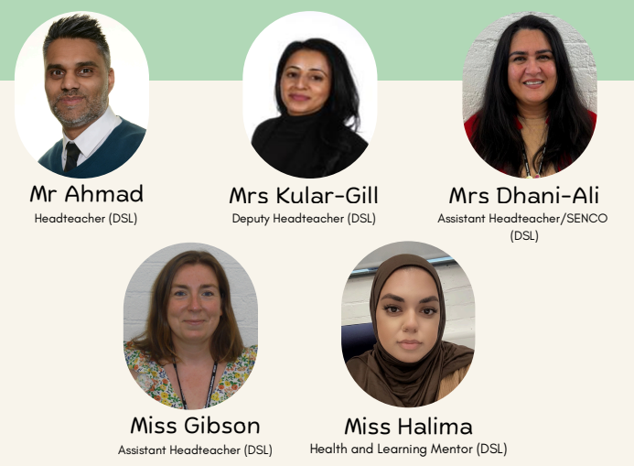

SLT and Designated Safeguarding Lead/Deputies
Deputy DSL
Lead DSL
Deputy DSL
Deputy DSL
Deputy DSL

Slide 4
Class Inkpen
Mrs Styles
Mrs Habib
Miss Anisa
Class McKee
Mrs Hussain
Miss Sara
Miss Anisa
Class Carle
Mrs Choudhary
Ms Akhtar
Meet the team– EYFS

Slide 5
Excellent attendance is a pre-requisite of academic success
Aim to attend school every single day (8:45 – 3:10)
Any pupils arriving less than 30 minutes late (8:45 – 9:15am) will be marked using an L code.
If a pupil is more than 30 minutes late without a very good reason, the pupil will be marked as an unauthorised late (a form of unauthorised absence).
Avoid medical appointments during school time. Evidence required.
Absence calls on 0121 464 3618 before 8:45am.
If absent for more than 3 days within one half-term for the same reason, medical evidence is required.
Leave of Absence During Term Time request will be denied unless there are exceptional circumstances (rare, significant, unavoidable and short). Form and evidence required in advance.
Referral to LA following 20 sessions (10 days) of unauthorised absence = fine.

Slide 6
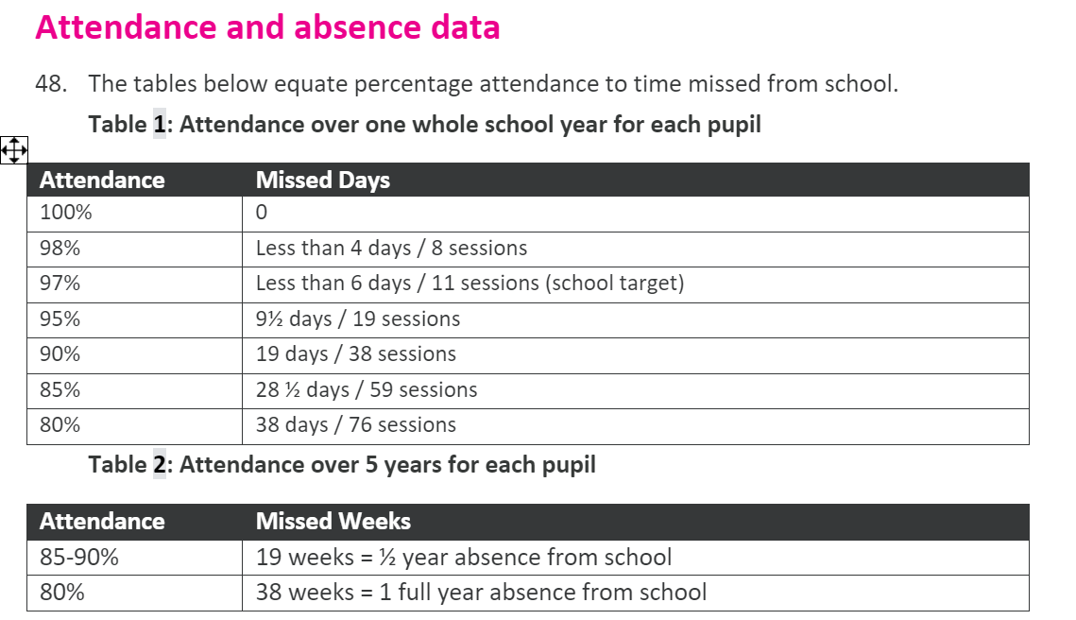
Excellent attendance is a pre-requisite of academic success

Slide 7
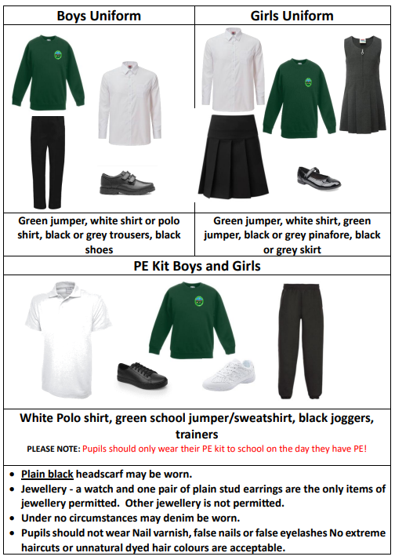
Springfield Primary Academy Uniform:

Slide 8
Personal Development/Enrichment
At Springfield Primary Academy we want to:
Promote Holistic Development - Ensure all pupils are supported to grow personally, socially, and emotionally, with a clear focus on wellbeing and character.
Enrich Through Curriculum - Deliver a broad curriculum that deepens pupils’ spiritual, moral, social, and cultural understanding, preparing them for life beyond school.
Develop Talents and Interests - Provide inclusive opportunities for pupils to explore and develop their talents and interests through enrichment, leadership, and extracurricular activities.
What we do: Helen give examples of how we enrich and what we offer

Slide 9
Communication
Face-to-face – Senior Leaders and teaching staff available (drop off, dismissal, parents’ evening, workshops etc)
The School Website - is updated regularly. Check out the ‘Primary News’ section.
Twitter - used to share and celebrate children’s and school achievements and successes. Springfield Primary Academy (@SpringfAcademy) / X
Email: enquiry@springfieldacademy.org.uk
Telephone:01283 246 433
Newsletters – sent out half termly by SLT
Text Message – Announcements via text message are used by the school to remind you of important information, deadlines, and regular updates.

Slide 10
Key reminders:
Administration of Medication - Where possible, all medication, such as antibiotics, should be administered at home. Parents must inform the school if they wish any prescribed medication to be administered. The school will require parents to sign a consent form and a Health Care Plan may be created if necessary.
Health Snacks - All snacks brought into school must be healthy.
Water Bottles - permitted to bring named water bottles filled with water.
Free School Meals Entitlement - If you have not already done so, please check your child’s eligibility by clicking on the following link https://www.gov.uk/apply-free-school-meals and completing an application.
Walk to School - respect our neighbours, keep pupils safe

Slide 11

Read Write Inc – EYFS/KS1
ks2 to add what reading looks like in ks2 – add how parents can support with reading
We teach children to read and write using the Read Write Inc (RWI) Phonics scheme.
RWI is a systematic, structured approach to teaching Reading and Writing which is designed to ensure every child can learn to read and write successfully. The program is designed so no child is left behind.
RWI lessons are taught daily, beginning as soon as the children join Reception. This ensures children make a strong start in Reading from the outset.
It is important that children practise their reading daily at home to support their fluency and comprehension.

Slide 12
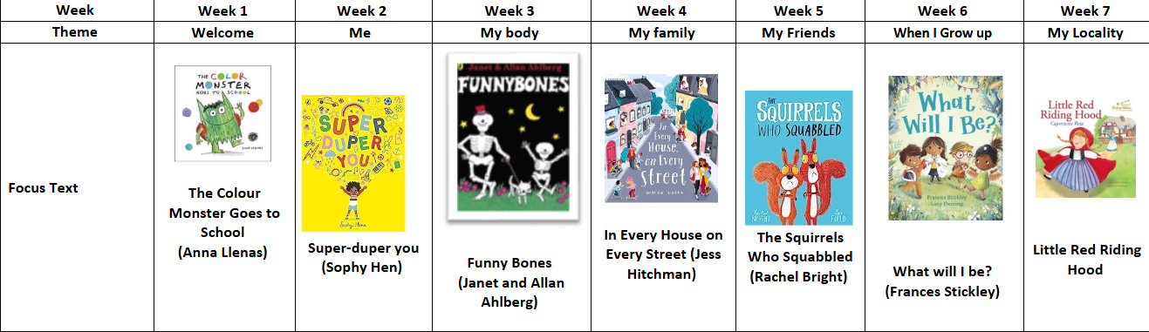
Reception Curriculum Overview
EYFS Curriculum – At a Glance:
Prime Areas – Physical Development, Personal, Social and Emotional Development and Communication and Language
Specific Areas – Literacy (Reading and Writing), Maths, Understanding the World, Expressive Arts and Design

Slide 13
Trips and Visitors
December – A walk across the road to visit our local church, St Christopher’s and learn
about the Christian festival of Christmas.
Spring Term – a workshop in school focusing on role play and our topic ‘People Who Help Us’.
Summer Term – A trip to Attwell Farm in Redditch to tie in with our topic ‘Down at the
Bottom of the Garden.’
All year – seasonal walks to our allotments.

Slide 14

11b411:
Whilst the provision of opportunities is vital, the impact that participation creates is more important. Through the delivery of 11BEFORE11, we are not only looking to open our pupil's eyes to a world of new opportunities, but also to help them develop the skills and experiences required to thrive and develop in their future lives.
Across our broad and diverse Trust there is huge diversity. Although this is very much welcomed, it also stimulates a range of life challenges for the young people we support. For example, some of our children will have very little chance to spend time in the countryside, others will never have the opportunity to experience different countries and cultures, similarly many will never consider engaging with the arts.
Through the delivery of 11BEFORE11, we aim to overcome as many of these challenges as possible. Some of these are detailed below.
11BEFORE11 will enable all REAch2 children, irrespective of their circumstances to:
Enjoy the great outdoors
Experience the arts
Embrace new cultures
Challenge their adventurous spirit
Stretch their comfort zone
Build new life skills
Support the community within which they live.
Through 11BEFORE11, we aim to deliver an enhancement in the following areas:

Slide 15
Thank you
Questions?

