Slide 1




Special Educational Needs (SEN) Information Report
Springfield Primary Academy

Slide 2
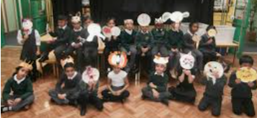
Welcome
Welcome, I am Morney Dhani-Ali and I co-ordinate our provision for children with Special Education Needs and Disabilities (SEND) here at Springfield Primary Academy. Mrs Irrim is the SEND Intervention Lead and Speech and Language Champion.
You can contact me or Mrs Irrim during school hours by emailing: enquiry@springifeldacademy.org.uk or by calling the school on 0121 464 3618
However, I do ask that if you are concerned about your child that you speak to their class teacher in the first instance as they are best placed to answer any questions that you may have.
The Governor responsible for SEND at Springfield Primary Academy is Sofina Chohan, please speak to the school office if you would like to speak with her.

Slide 3

At Springfield Primary Academy we comply with The Children and Families Act 2014 and Disability Regulations 2014. We make provision for pupils with difficulties in one or more of the four areas of need (Cognition and Learning, Communication and Interaction, Sensory and/or Physical Needs, Social, Emotional and Mental Health). The school SEND information report will provide a guide to SEND provision in the academy, however, each child’s needs will be addressed on an individual basis.
Our primary methods of support for children with SEND needs are through methods of adaptation, enabling learning environments and the use of quality first teaching strategies. This means that activities are planned according to the level and needs of the child. They may be provided with additional resources, adult support, varied teaching strategies or changes to the physical environment.

Slide 4
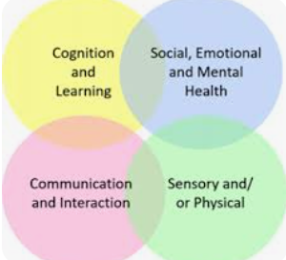
Kinds of SEN provided for
A pupil has SEN where their learning difficulty or disability calls for special educational provision, this is provision different from or additional to that normally available to pupils of the same age.
At Springfield Primary Academy, our SEN provision is considered as falling under four broad areas:
Cognition and Learning: Children and young people who find learning, thinking and understanding harder than their peers.
Communication and Interaction: Children and young people who find it difficult to interact with the people and the world around them.
Sensory and/or Physical Needs: Children and young people who have a disability that may make it difficult for them to manage their everyday life without support. This may be due to hearing, visual and physical difficulties or other medical needs.
Social, Emotional and Mental Health: Children and young people who find it difficult to manage their emotions and behaviour in a way that affects their daily life.

Slide 5
Further details on the four areas of SEND need can be found on the school website.
Local authorities are required to provide a 'local offer' for children with Special Educational Needs and Disabilities and their families; Birmingham's offer can be found at www.localofferbirmingham.co.uk .
The Special Education Needs and Disabilities Information, Advice and Support Services (SENDIASS) exist to provide advice and information to parents and pupils in Birmingham with all matters relating to SEND. They can be contacted via email on sendiass@birmingham.gov.uk or by telephone on 0121 303 5004.

Slide 6

Who should parents speak to if they have concerns regarding their child?
A concerned parent should always approach the
Class teacher first. The teacher will have an up-to-date knowledge of your child and will be able to share any difficulties they are experiencing, and adaptations already being made for them.
As part of their continued assessment, teachers will be aware of children with gaps in their learning and those who need additional support or adjustments to help them learn. They will share this information with parents and discuss their concerns with the school SENDCo.
Parents can also speak with the SENDCo to discuss any concerns they may have. The best way to contact the SEND team is by telephoning the school office on 0121 464 3618 or sending an email FAO the SENCo to enquiry@springfieldacademy.org.uk.

Slide 7

What support is available for pupils identified as having a SEND need?
The support provided to a child will vary according to their need and ability to work independently. The following list explains some of the strategies that we use:
Scaffolding – where children are provided with a framework and/or prompts to help them complete a task.
Learning Objective adaptation – when children are given a focus/aim for their learning at a level appropriate to their needs.
Additional resources – children may be provided with word banks in writing or practical resources in other subjects.
Additional support during a lesson – working with an adult to support children to learn things they find difficult.
School Support Plan – individual targets to show what children need help with and how it will be provided.
Referral to specialist agencies – specialist teachers will provide advice on a child’s needs and how best to support these needs.

Slide 8

How will the school let parents know if they have concerns about their child?
Teachers continuously assess pupils’ abilities to complete the tasks they have been set and their independence and engagement in learning. Reading, writing and maths assessments to measure children’s retention and transferring of learning take place termly. Teachers will share their overall judgements with parents during parent consultation events. A class teacher may request to meet a parent and share concerns outside of parent consultations where they have a concern. Parents of children identified as having a SEND need will also have the opportunity to meet with the SEND team to review their child’s targets.

Slide 9

Who are the people that provide SEND support at Springfield Primary?
Agency or Service | Who they work with
School Pastoral team | Children displaying social, emotional and mental health difficulties
School SEND intervention lead | Identified children needing specific intervention as directed by outside agencies
School teaching assistants | Children in the class or small group environment who need additional support to succeed in learning
Pupil and School Support (PSS) | Children with Cognition and Learning difficulties which impacts on their access to learning.
Physical Difficulties Support Service (PDSS) | Children with physical difficulties affecting their mobility and access in the school setting. School request support from PDSS.
Communication and Autism Team (CAT) | Children diagnosed or undergoing assessment for Autism or communication difficulties. School refer to CAT with parent consent.
Education Psychology Service (EPS) | Children with complex needs, Social Emotional and Mental Health needs and children with or referred for an Education, Health and Care Plan. School refer to EPS with parent consent.
Sensory Support service | Children with a significant hearing or visual impairment
School Nurse | Children with medical needs. Schools can refer to the school nurse service
NHS Physiotherapy service Paediatricians | Will advise SENDCo on provision the academy need to make for specific individuals. School can refer to community paediatricians
Speech and Language Therapy (SALT) | Children with significant speech and language difficulties. School can refer to SALT with parent consent.
Occupational Therapy (OT) | Children with physical difficulties. School can refer to OT with parent consent.
Forward Thinking Birmingham | Children with a high level of emotional and well-being difficulties. School can refer to Forward Thinking Birmingham with parent consent. Parents can use the Pause drop-in service in Digbeth.

Slide 10

What training do the staff in school have in relation to pupils with special educational needs and disabilities?
Mrs. Dhani-Ali, our SENDCo, holds the National Award for SEN Coordination. All members of staff have received training in relation to supporting the needs of children with SEND. Some staff have received additional training to support children in their classes with specific needs.
Recent training has included:
Understanding the four areas of SEND need
Strategies to support children with SEND in the classroom
Creating an inclusive learning environment
Supporting children working below age related expectations
WellComm language assessment
Supporting medical needs (asthma and allergy)
Supporting pupils on the autism spectrum through the AET standard

Slide 11

How will Springfield measure the progress of SEND pupils?
All children’s progress, including those identified as having SEND, is tracked using the school’s assessment tracking system. Pupils are assessed regularly using marking and feedback, observations and questioning as well as through the use of more formal assessments such as curriculum, standardised and statutory tests. For pupils with additional learning needs, we also use the Birmingham Language and Literacy and Maths continuums; these support assessing and evidencing small steps of progress and are used to support the setting of individual learning targets. These targets are shared with parents and reviewed formally throughout the year.

Slide 12

How is extra support allocated to children?
The school receives SEND funding as part of its overall budget allocation each financial year. A significant portion of this money contributes to the salaries of those working with SEND pupils. It is also used for the following:
To provide additional support or resources for an individual or group of children following assessments
To ‘buy into’ the services of outside agencies such as Educational Psychology Service
Purchase of licence fees for assessment tools that allow us to accurately identify a need, support and track the progress of children receiving intervention
Training for school staff to ensure they are able to meet specific pupil needs
To purchase resources to support pupil’s learning

Slide 13

How will the school prepare and support pupils when joining Springfield Primary Academy, moving classes or transferring to a new school?
We are aware that moving to a new class or school can be a stressful time for children and their families. As such, we have many strategies in place to ensure transitions are smooth and successful.

Slide 14
When children are joining Springfield, we:
Invite parents to an induction meeting, where their child’s needs can be shared
Provide a tour of the school for the child and parent before starting
Make contact with previous schools/settings
Provide transition books (where required)
Receive and read reports from outside agencies and use these to decide provision
Share SEND information with the child’s class teacher

Slide 15
When children are moving classes, we:
Provide updated transition books (required)
Facilitate additional opportunities for the child to engage with their new teacher/teaching assistant
Ensure that staff welcoming new children with SEND have all the necessary information about how to support their learning
Talk to the child and their family, so we can answer any questions they may have about their new year group and class

Slide 16
When children are moving schools, we:
Hold a review meeting and invite staff from the new school
Arrange additional visits to the new school with a familiar member of staff (if required)
Talk to the child and family, so we can answer any questions they may have about the new school
Share information with key staff at the new school about things that help the child to learn well and be happy at school

Slide 17

Child and parent will be invited to contribute at meetings to review and agree targets
Information from professionals will be shared with parents
Opportunities for parents to meet with the class teacher or a member of the SEND team
Self-assessment opportunities for children
Feedback provided to children on their learning activities
How will we involve and support children and their families in decisions about their education?

Slide 18
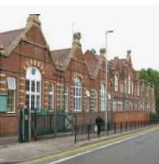
We hope that you find this information useful. We understand families may have questions that have not been answered in this document and encourage you to contact the school and make an appointment to speak with a member of the SEND team to ensure that you are confident how your child’s SEND needs are being addressed.

Slide 19

Parental Involvement
Parents of all children on the Special Educational Needs register are invited to a One Planning Meeting (the name for a Person-Centred meeting in Essex) where we talk about what we like about the child, what is important for them and what is work working or not working for that child in school. We hold these meetings twice an academic year or every term if there are concerns raised by parents, teachers or the child themselves.
Parents of a child with SEND are also given an extended time during parents evening.

Slide 20

Child Involvement
Children are invited to One Planning meetings to share their views. Some stay for the whole meeting, but where appropriate, we collect the child’s views before the meeting using different methods such as questionnaires or using pictures to communicate ideas.
Children are also invited to parents evenings to share their views.

Slide 21

Problems and Complaints
We believe that working together almost all problems can be solved in the best interest of our children.
If you have a problem, you should speak with your child’s class teacher in the first instance.
If the problem or concern persists then you can arrange a meeting with the class teacher and the SENCO and/or the Headteacher(s) through the school office.
If the problem or concern persists then you can arrange a meeting with the SEND Governor.
Complaints are followed in line with our school and REAch2 policy which can be found on our school website.

Slide 22
Organisations we work with
We are an Academy, however we do still work closely with Essex County Council education services such as Educational Psychology, Specialist Teacher and Pre-School Service and Statutory Assessment Service.
NHS services such as Community Paediatrics, Speech and Language Therapy service, Occupational Therapy Service, Incontinence service and Emotional Wellbeing Mental Health service.
Child and Family Art Psychotherapy.
The University of Essex Speech and Language and Child Counselling students.
The GROW Provision.
Family Solutions who offer the Piece it Together Course for parents of children with ADHD and Autism.
Autism Anglia.

Slide 23

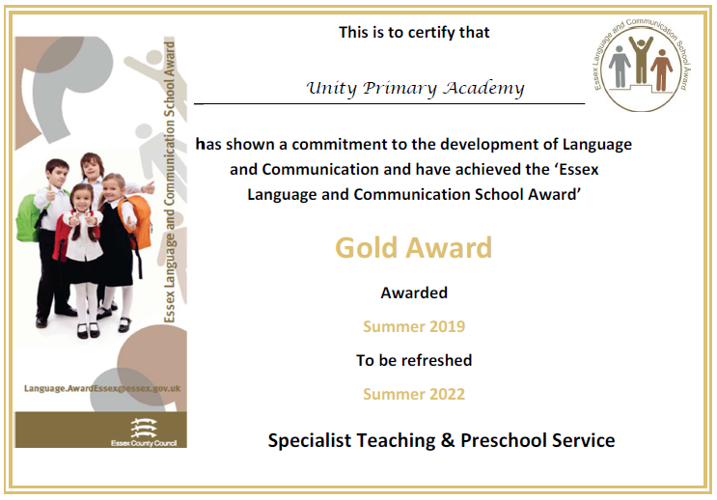
Testimonials
Click here to read some quotes from our Ofsted report about SEND at Unity Primary Academy.
We achieved a Gold Award for the work we do to develop our children’s speech and language skills.

Slide 24
Ofsted 2017
‘Provision for pupils who have special educational needs and/or disabilities is very well managed. The inclusion leader has ensured that effective systems are in place so that pupils’ needs are identified fully and promptly. Individualised programmes are put in place that successfully meet the needs identified. The additional funding that the school receives for pupils who have special educational needs and/or disabilities is spent very well and outcomes for this group of pupils are clearly improving.’
Teachers and teaching assistants are highly skilled at managing pupils whose behaviour is challenging. Clear plans are in place for each of this small group of pupils. Staff show a high level of understanding of why pupils behave in the way that they do. This means that they are highly effective in helping pupils to reduce their undesirable behaviours and express their frustrations and distress in more socially acceptable ways.
Leaders have introduced a commercially produced programme aimed at protecting and improving pupils’ social, emotional and mental health. The inclusion leader is fully trained in the use of the programme and has provided training for other members of staff. The school has found that this approach is having a demonstrable impact on improving many pupils’ self-esteem and thus their ability to learn

Slide 25
Ofsted 2017
The school focuses very well on developing pupils’ speech and language skills. Two specially trained members of staff work full time in this area. They are supported by weekly visits from a speech and language therapist, funded by the National Health Service. This provision has a clear impact on improving the communication skills of the pupils whom staff work with.
Teaching assistants are an asset to the school and make a significant contribution to improving outcomes for pupils. For example, teaching assistants run effective ‘catch-up’ groups that help pupils to improve their reading and spelling. Teaching assistants are also highly skilled in managing pupils’ behaviour, including when it is more challenging.
Teachers and other staff focus very well on promoting pupils’ self-esteem and taking care of their mental health. Staff fully appreciate that one of the responsibilities of their roles is that they hold pupils’ self-esteem in the palm of their hands. They consciously carry it carefully rather than carelessly crushing it.

